Slide 1


ENVIRONMENT AND SUSTAINABILITY PRESENTATION 2023 -2024

Slide 2
CONCORDE DE LUXE RESORT SUSTAINABILITY ACTIVITIES
The concept of sustainability is becoming more and more important in our lives every day. For this reason, since the first day of our hotel's establishment, steps have been taken especially for the environment and sustainability, and positive developments have been added to it every year, making it one of our basic concepts.
Sustainability in the tourism sector is closely monitored and carried out in integration with our organization.
As Concorde De Luxe Resort, the basic elements of sustainable tourism have been evaluated separately as a single subject. Within the scope of the basic elements, the actions taken in our hotel have been detailed.

Slide 3
CONCORDE DE LUXE RESORT
BASIC SUSTAINABILITY ACTIVITIES
Protection of natural resources
Protection of natural environments and living things
Planning social responsibility projects
Supporting the economy and local people
Use of environmentally friendly energy sources and devices,
Chemical use and monitoring,
Control and evaluation of waste,
Promotion and protection of our historical and cultural wealth
Providing information about our sustainability activities and evaluating the feedback received

Slide 4

CONCORDE DE LUXE RESORT SUSTAINABILITY ACTIVITIES
Protection of natural resources
Natural resources are natural riches that ‘have no human influence in their formation’ and are formed ‘depending on certain conditions in the natural environment’.
In particular, the consumption of natural resources such as electricity, water and natural gas used in our facility is monitored daily, monthly and annually.
Actions are taken to reduce the consumption of natural resources and annual reduction targets are set and followed up.
Regional consumption is also carefully monitored with the help of filter meters.

Slide 5
CONCORDE DE LUXE RESORT SUSTAINABILITY ACTIVITIES
Protection of natural resources
Energy consultancy is especially focused on the correct use of natural resources.
Our personnel are made aware of the correct use of energy in line with the training plan created.
In addition, our guests, visitors and suppliers are informed about the protection of natural resources on our website, info channels and visual brochures.

Slide 6
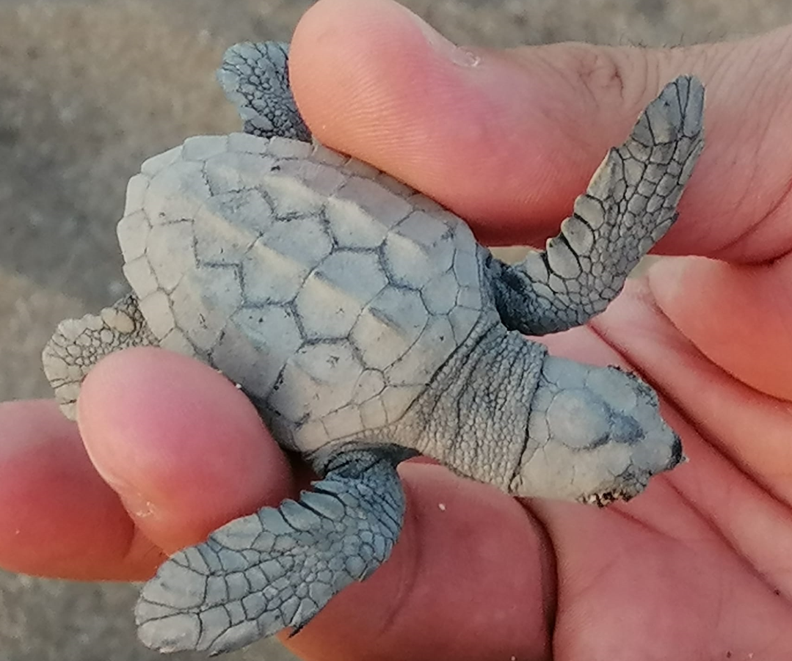
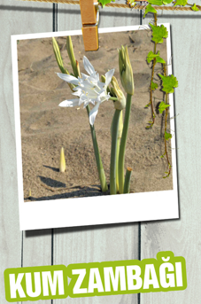
CONCORDE DE LUXE RESORT SUSTAINABILITY ACTIVITIES
Protection of natural environments and living things
Concorde Deluxe Resort within the body of protection under found endemic plants and shelters animals that are in danger of extinction .
Caretta Caretta's coming to our beach for spawning season for protection There are cages and information signs.
Endemic plants for protection And growing areas have been created. Especially the sand lilies and myrtle plants have been protected, and guests have been informed.
Our facility has a greenhouse application, and the propagation of locally known plant species is carried out.
In addition, plant species specific to the Mediterranean climate are allowed to spread in the facility's landscape and natural features are preserved.

Slide 7
CONCORDE DE LUXE RESORT SUSTAINABILITY ACTIVITIES
Protection of natural environments and living things
Wooden bird nests were hung on our trees in the facility, especially for the winter months, and bird waterers were made for the summer months.
Cat feeding stations were set up at certain distances within the facility and cat houses were built.
Tree naming studies have been carried out to increase awareness of plants found in natural environments.

Slide 8

CONCORDE DE LUXE RESORT SUSTAINABILITY ACTIVITIES
Planning social responsibility projects
Social responsibility projects general topics poverty , health , education , gender​​​​ equality , Person rights And environment consciousness creation of , Woman, child And animal your rights protection , Disabled individuals to society to be gained like Topics is forming .
In particular, we provide support to our staff in their careers by organizing external training programs such as business development and professional qualifications.
Special discounts have been provided for our employees with the private hospital we have an agreement with.
The same rights have been established for our personnel who are not Turkish citizens.
In various organizational structures in our facility, our disabled personnel are provided with employment rights and support is provided to them in establishing their careers.

Slide 9

CONCORDE DE LUXE RESORT SUSTAINABILITY ACTIVITIES
Planning social responsibility projects
In line with the decision we made in our facility, a "Social Committee" was established, open to all employees.
Social Committee Duties:
Sustainability And social responsibility of the project's preparation,​
In the city art and cultural activities Announcement And Participation encouragement to be done,
Departments inter- tournaments organization ( backgammon - chess - bowling - ping pong etc. ),
Employee activity And set Spirit collection of suggestions .

Slide 10

CONCORDE DE LUXE RESORT SUSTAINABILITY ACTIVITIES
Supporting the economy and local people
Our Facility within the body of 43% of employees Mediterranean, It is located in the region .
In order to increase local employment, The Mesem program (Vocational Education Center) is continuing to provide vocational training to young people who have not finished high school by taking them into the formal education program.
We have a total of 1940 suppliers for services and products. In total, 33% of the work is done with companies outside Antalya and 67% with local companies.
While attention is paid to local purchasing, there are also sales areas within the facility for sales to be made within the hotel.

Slide 11

CONCORDE DE LUXE RESORT SUSTAINABILITY ACTIVITIES
Use of environmentally friendly energy sources and devices,
«Purchasing Policy» has been created and published for the use of environmentally friendly energy sources and devices .
CONCORDE DE LUXE RESORT SUSTAINABLE PURCHASING POLICY
The main goal of our hotel is to provide the best quality service with the support of all our collaborators. In line with this goal, all purchased products are evaluated and purchased within the scope specified below;
Always support local producers and make purchases from local suppliers whenever possible,
To introduce local products and traditions to guests,
To work with companies that have fulfilled all legal requirements regarding environment and energy,
Working with companies that have adopted environmental and energy policies and support recycling,
To ensure that domestic products are always given priority over imported products,
Choosing products that cause less waste,
Not using products that consume energy other than A – B energy groups unless necessary,
Not purchasing products that contain harmful gases,
Competing in national and international markets, our Hotel demonstrates the determination required for the continuous development of not only its employees but also its collaborators in order to achieve better things.

Slide 12
CONCORDE DE LUXE RESORT SUSTAINABILITY ACTIVITIES
Use of environmentally friendly energy sources and devices,
Our provider of electricity, one of our most important energy consumptions, has an I-REC (Renewable Energy Certificate).
Our Facility clear One in the field sun panels in use And renewable energy is provided.
Used machine And in equipment energy to their classes suitable purchase is being made and is pursued as an environmental target.
Per Person consumed electricity, water and natural gas The amounts are calculated daily, monthly, quarterly and annually and followed as environmental targets.
Our facility energy savings about environment-energy targets And projects follow up and improve​ to its activities weight is giving .
Guests are provided with bed linen and towel change warning cards and information about environmental awareness.
There are 2 electric charging stations in our facility, and they are available for our guests' use.
As a facility, all conditions are met as a bicycle-friendly hotel to reduce

Slide 13

CONCORDE DE LUXE RESORT SUSTAINABILITY ACTIVITIES
Chemical use and monitoring,
Monthly field tours are conducted by our Environmental and Hazardous Materials Consultants.
Housekeeping, Laundry and Stewarding chemical consumption per person and washing per person are monitored monthly.
Green tagged chemical products like environment friendly chemicals preference to be done and next period for is being targeted .

Slide 14

CONCORDE DE LUXE RESORT SUSTAINABILITY ACTIVITIES
Control and evaluation of waste,
First of all, waste separation is carried out at the source in the guest and staff areas of our facility and delivered to licensed companies.
The amount of organic and packaging waste collected at the end of the month is reported by the company.
Waste requests for hazardous waste are made through the electronic system and the disposal status is also monitored through this system.
The Annual Hazardous Waste Declaration is made by hazardous material consultants and reported to the relevant official institutions.
It is determined as an environmental and energy target and monthly waste amounts are monitored and evaluated in Management Review meetings.

Slide 15
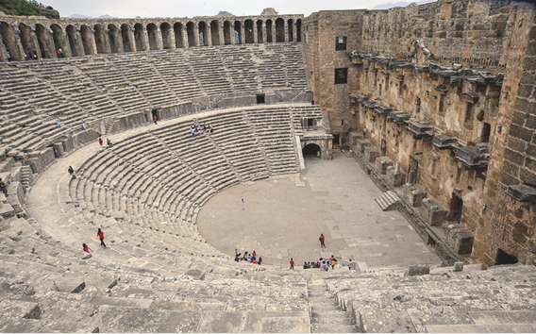
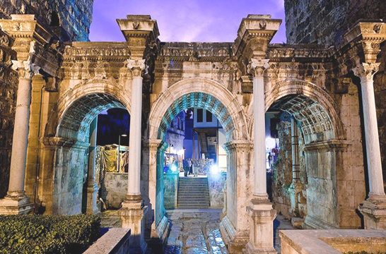
CONCORDE DE LUXE RESORT SUSTAINABILITY ACTIVITIES
Promotion and protection of our historical and cultural wealth
Info TVs provide information to our guests and staff about the promotion and protection of our historical and cultural riches.
Antalya Provincial Directorate of Culture and Tourism shares cultural information about Antalya and provides information on how to reach it.
There is also information explaining the rules to be followed when visiting museums, historical sites, and cultural areas.

Slide 16
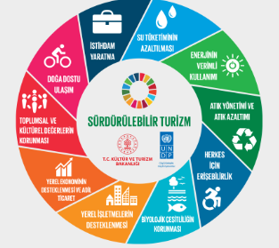
CONCORDE DE LUXE RESORT SUSTAINABILITY ACTIVITIES
Providing information about our sustainability activities and evaluating the feedback received
Sustainability Report 2023 -2024 year for published and website​ over relating to the parties' access to is presented clearly .
Requests/demands/suggestions from guests regarding environmental and sustainability issues daily aspect are evaluated and feedback is provided to the guests regarding the actions taken.
The issue of sustainability is added to the environmental surveys included in our guest satisfaction survey and is evaluated on a daily, weekly, monthly, quarterly and annual basis.
In addition, feedback from guests is evaluated in management review meetings every three months.

Slide 17




CONCORDE DE LUXE RESORT SUSTAINABILITY AWARDS

Slide 18

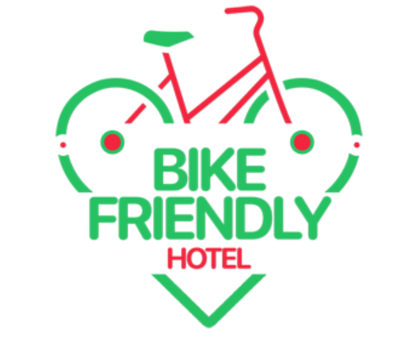



CONCORDE DE LUXE RESORT SUSTAINABILITY AWARDS

Slide 19







CONCORDE DE LUXE RESORT
ISO - QUALITY CERTIFICATES

